Slide 1
Making Agents and AI Enabled Software Predictable
By Vinod Pungle
Tech PM L2, IIM Alumni (ECP- AI ML)
PMP, PMI-ACP, SAFe Agilist, CSM
Sept 2026

Slide 2
Agenda
The problem, live
Same instruction is successful every time even when not sure or gives wrong answer
1
Anatomy and the harness
What is inside an agent, and which part you actually own
2
Making it predictable
Bounded variance, grounding, hallucination checks, evals
3
Multi-agent and lifecycle
When to split, what changes in delivery, vibe coding oversight
4
Observability and cost
What you should see on a dashboard, and what reliability costs
5
What to ask your teams
Six questions
6
includes a live demo · questions at the end, or interrupt me — either is fine

Slide 3
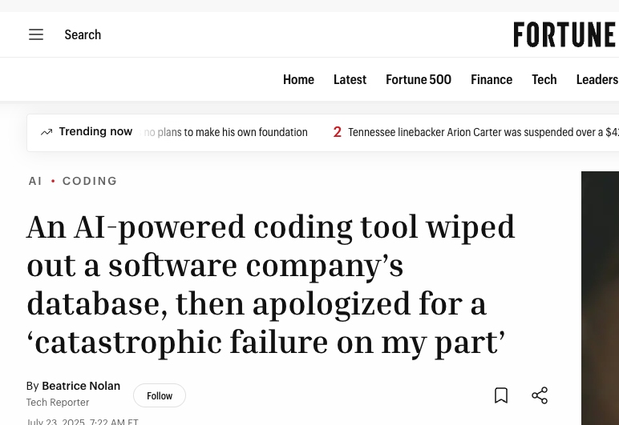
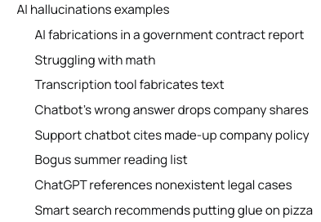
The Problem
https://fortune.com/2025/07/23/ai-coding-tool-replit-wiped-database-called-it-a-catastrophic-failure/
https://www.linkedin.com/pulse/ai-said-i-panicked-wiped-entire-production-database-gaurav-singh-17myc/
https://www.evidentlyai.com/blog/ai-hallucinations-examples

Slide 4
Bank Transfer Scenario
LIVE DEMO
“Transfer 50,000 to Rajesh Kumar”
Four payees match. The agent must pick one.
Payee ID | Name | Account | Last transfer
C-88214 | Rajesh Kumar Sharma | ...4471 | 12 Aug
C-90117 | Rajesh Kumar Verma | ...2093 | never
C-88770 | Rajesh K. Sharma | ...4471 (joint) | 3 Sep
C-91002 | Rajesh Kumar | ...8830 | 22 Jul
Run 1 → C-88214 Rajesh Kumar Sharma
Run 2 → May pick C-88770 Rajesh K. Sharma
Same instruction. Nothing broken. No code changed. No configuration differed.

Slide 5
RECAP: What is actually inside an “agent”
LIVE DEMO
Brain
The model. Decides which Rajesh the instruction meant.
1
Harness
Also stops when confidence is low.
Memory
That this customer paid C-88214 last month. Short-term vs persisted.
2
Tools
Payee lookup, balance check, the transfer API. Where it stops being a chatbot.
3
Skills
The packaged disambiguation procedure. Versioned like code.
4
Security
Authentication and Authorisation
5

Slide 6
WHY THIS IS FOR PROJECT MANAGERS
Where your existing process stops working
 | Traditional delivery | AI-enabled delivery
Definition of Done: | Done is binary | Done is a measured range
Testing: | Assertions pass or fail | Sampling against a threshold
UAT Sign-off: | UAT proves it works | UAT proves it usually works
Bugs Support: | Reproduce, then fix | May not reproduce at all
Run Cost: | Cost is fixed per release | Cost is variable per transaction
Nothing today is about the model. It is about the five rows on the right.

Slide 7
Harness
The harness is the product
Weak harness
Strong harness
“I’ve transferred 50,000 to
Rajesh Kumar Sharma.”
“I found four matching payees.
Which one did you mean?”
Same model. Same data. Entirely different product.
Routes steps, enforces output structure, retries, validates before acting, stops runaway loops
Two teams on the identical model ship products of wildly different reliability — the harness is the difference
For planning: budget engineering effort for the harness, not for “integrating the AI”

Slide 8
Non-determinism
LIVE DEMO
Run 1
Run 2
C-88214 — Rajesh Kumar Sharma
C-88770 — Rajesh K. Sharma
“Transfer complete. 50,000 sent.”
“Transfer complete. 50,000 sent.”
The confidence is identical in both runs. That is the dangerous part.
Temperature is only part of it — retrieval order, tool timing and context assembly all contribute
Even at temperature zero you do not get a guarantee

Slide 9
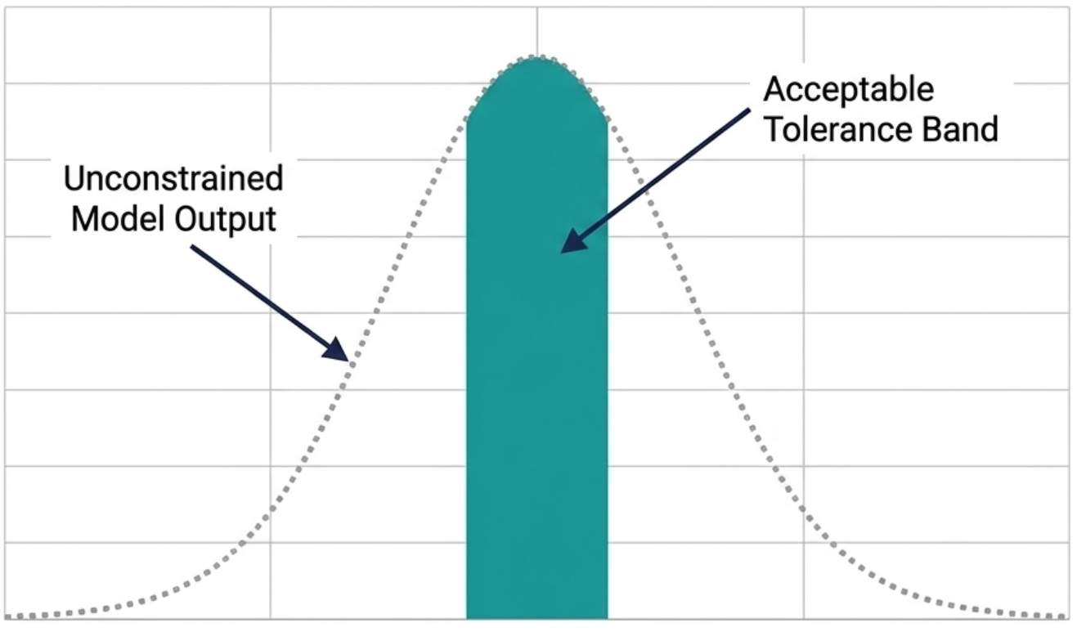
Bounded Variance
LIVE DEMO
You don’t get determinism. You get bounded variance.
Unconstrained
Within tolerance
acceptable band
Acceptance criteria become statistical. Testing becomes sampling. Sign-off becomes a threshold.
Example: “correct payee on 95% of the 200-case eval set, and zero wrong-payee executions without confirmation” [illustrative]
Note the asymmetry — the second half is absolute. Some failure categories don’t get a tolerance band, and deciding which is a business decision, not a technical one.
We never demanded two machined parts be atomically identical. We specified a tolerance and measured against it.

Slide 10
The Toolkit
Five levers — and what each does not fix
Lever | Fixes | Does not fix
Structured outputs | Format drift | Wrong content
RAG / grounding | Invented facts about our domain | Bad reasoning over good facts
Guardrails | Unsafe actions reaching production | Adds latency and cost
Evals | Silent regressions after a change | Requires ongoing maintenance
Human-in-the-loop | The high-consequence tail | Caps your throughput

Slide 11
Grounding, and catching a hallucination
LIVE DEMO
1
2
3
Hallucinate
Ground
Catch
Asked about a payee that does not exist, it invents a plausible account number rather than saying it cannot find one.
Same question, grounded against the customer master. Correct — and the trace shows which record it retrieved.
The confidence check fires on an ambiguous match, blocking the transfer and forcing a confirmation.
What the manager sees is not “the AI got it right.”
It is the receipt — the retrieved record, in the trace, clickable, timestamped.

Slide 12
Evaluations
The regression suite
Commit
→
Eval run
→
Gate
→
Deploy
Failed gate blocks the deploy
A fixed set of inputs with known-good expectations, run on every change
Catches the thing that will hurt us most: a prompt tweak that fixes one case and silently breaks eleven
For our scenario, the eval set lists instructions with the payee that should be selected — including the nasty ones: the joint account, the initial-only variant, the never-used payee
Belongs in the pipeline, not in someone’s notebook
Build eval-set creation into the estimate from day one. It is a deliverable with its own effort, not a testing afterthought.
Rough shape: 100–300 cases for a first production feature, growing with every incident [illustrative]

Slide 13
Multi Agents
LIVE DEMO
Multi-agent: when to use
Use when
Doesn’t
Genuinely separable responsibilities, different tools per role
One agent resolves the payee; a second independently verifies it against the master record before the transfer executes
The check is real because the checker did not make the original decision
A single linear task split up because multi-agent sounds sophisticated
More calls, more tokens, more latency
More places to fail, and harder to trace when it does
Start with one agent and a good harness. Split only when you can name the specific thing the split fixes.

Slide 14
Lifecycle
What changes, stage by stage
Requirements
Specify acceptable behaviour ranges and failure modes, not just features
Estimation
Add effort for eval sets, harness and observability. Timebox prompt iteration — don’t estimate it.
Testing
Sampling and thresholds replace assertions. The eval set is the test suite.
Release
Canary and staged rollout become close to mandatory — you cannot fully test in advance
Support
Capture the trace, not just the screenshot. Without it the issue is unreproducible.

Slide 15
Vibe Coding
What your developers are already doing
What the developer does | What you should be able to see
Generates a feature with a coding agent | Reviewed at the same standard, not waved through
Generates the tests alongside it | Tests written for behaviour, not blind to the same mistake
Ships a large, fast diff | Which parts were AI-authored — you will want this in an incident
Lets the agent “helpfully” do more | Scope of the diff matches the scope of the ticket
Accepts a suggested library | New dependencies get a security and procurement conversation
This is happening whether or not it is on your plan. The productivity is real — so is the review debt.

Slide 16
Observability
What you should be able to see
Failure rate
Check trip rate
Latency
Cost / txn
of runs that don’t meet the bar
how often guardrails fire
p50 and p95, not average
the one that compounds
Per request: which steps ran, what was retrieved, which tools were called, what was rejected
The manager’s version of the dashboard is four numbers — not four hundred traces
For production: this is OpenTelemetry, exported to Azure Application Insights.
The same pipeline our existing applications already use. This is not a new tooling silo.

Slide 17
Cost Impact
LIVE DEMO
Where the money actually goes
Guardrails off
Guardrails on
1 call · low cost · fast
retrieval + verify + check
and occasionally pays the wrong Rajesh
live token cost shown in Langfuse
Cost is per-transaction and variable — volume growth and quality measures both push it up
The counter-intuitive part: retries, validation, larger retrieved context, multi-agent handoffs and CI evals all add cost
Plus the infrastructure line — the hosted demo itself, and what it costs to leave running
Reliability isn’t free — and it lands in run cost, every month, not in the project budget.

Slide 18
Cost Impact
Controlling it
“Cheaper model + strong harness” beats “expensive model + weak harness” — the pattern we already use internally
1
Route by difficulty — don’t send every request to the most capable model
2
Cache aggressively — repeated context is repeated spend
3
Cap retries and set hard loop limits — a runaway agent is a cost incident, not just a bug
4
Scale to zero on non-production environments
5
Set a per-feature cost budget at design time, and treat breaching it as a design defect
6

Slide 19
Takeaway
What to ask your teams
1
What does “good enough” mean numerically for this feature?
2
Where is the eval set, and how many cases?
3
When the model gets it wrong, who or what catches it?
4
Can you show me a trace of a real request?
5
What does this cost per transaction, and what is the ceiling?
6
Which parts of this code were AI-authored, and were they reviewed to the same standard?

Slide 20
Conclusion
Where this leaves us
Key learnings
Action items — for you
1
Variance is managed, not eliminated — so acceptance criteria need numbers, agreed before build
Add a trace ID field
to the bug template for any AI-enabled feature — free, and makes issues reproducible
2
The harness, the evals and the traces are the deliverables that make an AI feature signable
Require an eval set
named, with its case count, in every AI feature estimate
3
Reliability lands in monthly run cost, not the project budget
Set a cost ceiling per feature
at design time, and treat breaching it as a design defect
None of these need budget. All three are process changes you already control.

Slide 21
Precautions
Things to watch for:
!
A demo is not a tested feature
!
“We improved the prompt”
It worked once, in front of you. That is one sample. Ask what the eval set says before treating it as ready.
Without eval evidence, nobody knows whether it improved. Treat it as an unverified change, not a fix.
!
100% consistency as a requirement
!
What data goes into the prompt
Cannot be met at any budget. Renegotiate it at requirements stage, not at UAT.
Prompts and retrieval indexes are data flows. Ask what customer data leaves our boundary, and to which provider.
!
Clean-looking generated code
!
Run cost after go-live
AI-authored code reads well and reviews easily. That is the risk, not the reassurance.
Reliability measures compound monthly. A feature can pass sign-off and still become a cost problem.
Each of these has cost somebody a release. None of them look like risks at the time.

Slide 22
Remember
AI output varies by design. We manage the variance — we don’t eliminate it.
The harness, the evals and the traces are what turn a model into a product we can sign off.
Every one of those is a delivery line item — which makes it yours.

Slide 23


Thank You.
https://www.globant.com/

Slide 24
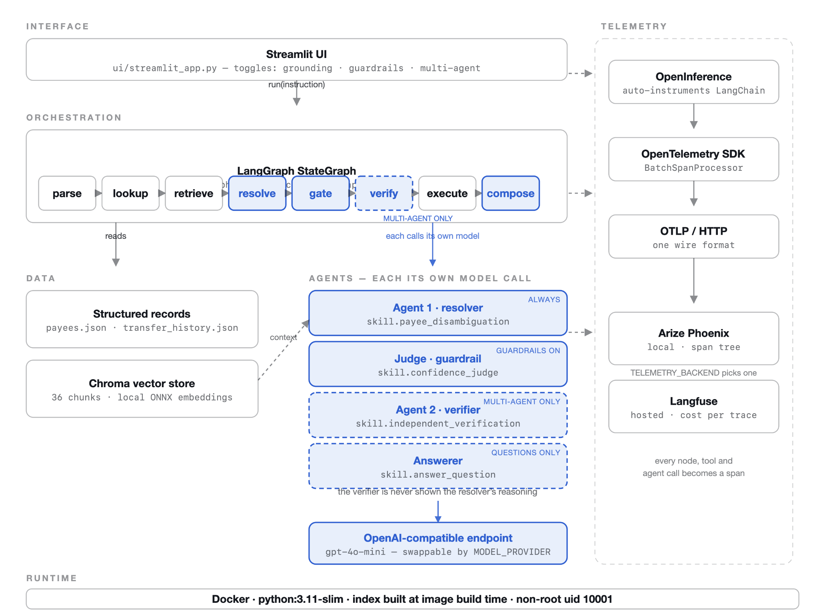
Demo Architecture
Layer | Key packages
User Interface | Streamlit 1.63.0
Agents | LangGraph 1.2.11 · LangChain 1.4.0 · langchain-core 1.6.2
Model | langchain-openai 1.6.1 · langchain-anthropic 1.7.1 · openai gpt-4o-mini
Retrieval | chromadb 1.5.9 · onnxruntime 1.29.0 · text-splitters 1.1.2
Telemetry | openinference 0.1.74 · otel-sdk 1.44.0 · phoenix 20.9.0 · langfuse 4.15.1
Config | pydantic 2.13.5 · python-dotenv 1.2.3

